Slide 1
Catch a Volatility Contraction Pattern (VCP)
Breakout in Taiwan Market
Pin Yu Chen, Alice
20241014 VCP in Taiwan

Slide 2
Motivation
Target
Methodology
VCP in Taiwan

Slide 3
Motivation
Motivation
Inspired by Mark Minervini's success: His outstanding victory in the 2021 U.S. Investing Championship, with an annualized return of 338.42%, captured my interest.
Mastery of the VCP: Minervini’s consistent use of VCP to identify breakout stocks highlights the pattern's efficiency.
Focus on strong price action: His strategy involves selecting stocks with both technical strength and solid fundamentals.
Interest in VCP’s application in Taiwan: Motivated by its success in the U.S., I seek to explore VCP’s potential in Taiwan's market for similar returns.
VCP in Taiwan

Slide 4
Motivation
VCP Overview
Objective | Capture stocks with strong upward momentum in a short period.
Selection Criteria | Stock should be in the second stage of an uptrend.
 | Volatility Contraction: The stock must exhibit shrinking price volatility.
 | Strong fundamental support.
VCP in Taiwan

Slide 5
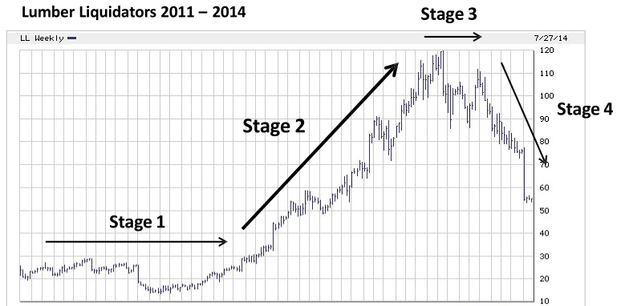
Motivation
Key Concepts
Stage 2 Trend: Stocks typically go through four stages (consolidation, uptrend, top formation, and decline). The most powerful uptrends happen in stage two.
VCP in Taiwan

Slide 6
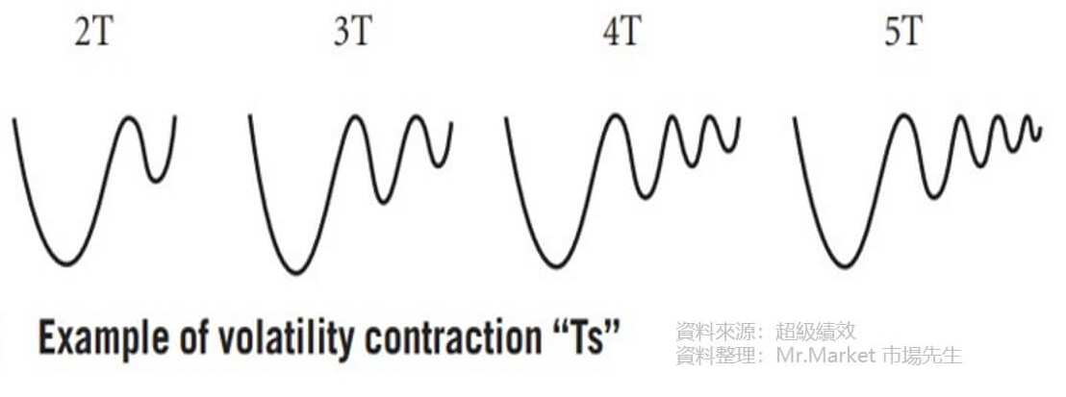
Motivation
Key Concepts
Volatility Contraction:
The development of the VCP pattern includes:
Price range contraction
Decreased trading volume
VCP in Taiwan
Notes:
The VCP is a price pattern characterized by larger price swings on the left side and gradually contracting volatility as it progresses to the right. Strong stocks typically undergo 2-6 contractions before a breakout. However, the key focus is not on the number of contractions but on whether the price volatility contracts significantly, coupled with a noticeable reduction in trading volume. When both conditions are met, it signals that the consolidation phase is nearing completion, and the stock is ready for a potential breakout.

Slide 7
Motivation
Significance of the VCP Pattern
Profit-taking pressure and supply lead to a decline in stock prices.
Entry point
neckline
Institutions bullish on the stock absorb the floating supply during price pullbacks, driving the stock price higher.
VCP in Taiwan
Notes:
The essence of the VCP pattern is a visual representation of market supply and demand for a stock. After a significant rise, profit-taking causes selling pressure, leading to an oversupply and a price decline. Institutions, seeing potential, absorb shares during the pullback, pushing the price up but below resistance. This cycle repeats with decreasing volatility and tightening price ranges. As the pattern narrows, it signals the end of consolidation. Once the price breaks through resistance, a small amount of buying can trigger a larger price increase, marking the entry point.

Slide 8
Target & Methodology
Target
Reduce maximum drawdown (MDD) while maintaining at least the same level of returns compared to previous backtesting results.
Methodology
Optimizing Stage 2 Parameters: Adjust the parameters used to identify stocks in the second stage of an uptrend, ensuring they fit the strategy's requirements more precisely.
Machine Learning for VCP Pattern Recognition: Train a model using image recognition techniques to detect the VCP pattern in stock charts.
VCP in Taiwan

Slide 9
Methodology
Backtesting Framework
Entry Point: Stocks that pass through the filters (optimized Stage 2 parameters, VCP pattern recognition, and fundamentals) will qualify for entry at the close of the trading day.
Exit Point: A dynamic exit strategy based on price deviation (e.g., significant divergence from a moving average) will be applied. For stocks that do not trigger this exit condition, the maximum holding period will be one week. Positions will be exited at the market open to account for Taiwan’s bearish tendencies with black candlesticks.
Data: The backtesting will use daily data from all Taiwan stocks over the past 10 years.
VCP in Taiwan

Slide 10
Volatility Contraction Pattern Analysis: The Case of Taiwan Market
Pin Yu Chen, Alice
20241014 VCP in Taiwan

